Slide 1
Network

Slide 2
Network
network consists of two or more computers that are linked in order to share resources , exchange files, or allow electronic communication.

Slide 3
Benefit
1. Fewer peripherals are needed
2.Greater communication capabilities
3.Lower cost
4. Centralized administration
5. Resources are conserved

Slide 4
Uses of network
Hardware and Software Sharing
Data and Information Sharing

Slide 5
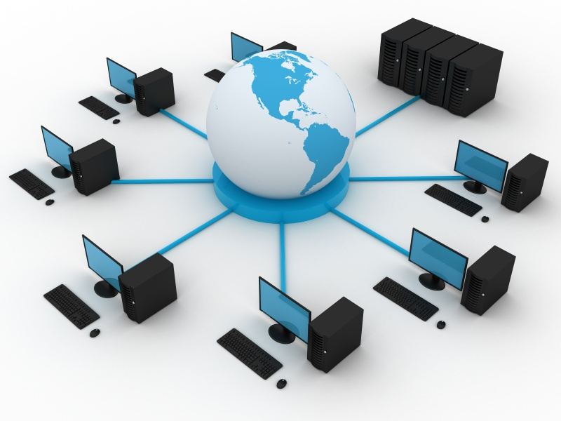

Slide 6
Server-client based network

Slide 7
Server-client based network
A Computer networking model where one or more powerful computers (servers) provide the different computer network services and all other users of the computer network (clients) access those services to perform the user's tasks is known as client/server computer networking model.

Slide 8


Slide 9
Advantages of Client-Server Architecture
Easy Management
Backup Security
Data Security
Data Sharing

Slide 10
Disadvantages of Client-Server Architecture
High Cost
Robustness
Maintenance Difficulty

Slide 11
Peer to peer networks

Slide 12
Peer to peer networks
In the peer to peer computer network model we simply use the same Workgroup for all the computers and a unique name for each computer in a computer network. There is no master or controller or central server in this computer network and computers join hands to share files, printers and Internet access.

Slide 13
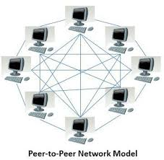

Slide 14
Advantages of Peer to Peer Networks
1. Such networks are easy to set up and maintain as each computer manages itself.
2. It eliminates extra cost required in setting up the server. 3. Since each device is master of its own, they an: not dependent on other computers for their operations

Slide 15
Disadvantages of Peer-to-Peer Networks
In a peer-to-peer network, the absence of a centralized server makes it difficult to backup data as data is located on different workstations.
Security is weak as each system manages itself only.
There is no central point of data storage for file archiving.

Slide 16
Difference between Client-server and Peer to Peer Networks
Client server model
Peer to peer model
It requires two types of machines.
Large memory
Specialized network operating system is required to manage usage of the model
Best model for large network
Network administrators are required to manage the system.
In p2p network all the devices have same power.
No specialized operating system is required to manage the network
Best model for small network
Peer to peer network is less secure

Slide 17
Thank you

